Slide 1
2025 Open Enrollment
2025 Open Enrollment
Navia Benefits Presentation

Slide 2
Navia Benefits offered by Rimini Street for 2025?
Sec. 125 FSAs
Health Care FSA (HCFSA)
Day Care FSA (DCFSA)
Limited Health Care FSA (LHCFSA)

Slide 3
What is Section 125?
WHAT IS A SEC 125 FSA?
Contributions/deductions are withheld from your paycheck on a pre-tax basis, thereby lowering taxable income, which means employees pay less in federal income tax and Medicare and Social Security taxes.
All monies deducted pre-tax are exempt from Federal Income Tax (FIT), FICA and even some state income taxes. This can result in savings of 30 - 40%
When you use your FSA to pay for eligible expenses you get to pay for expenses you were already going to incur and take home more of your paycheck!!

Slide 4
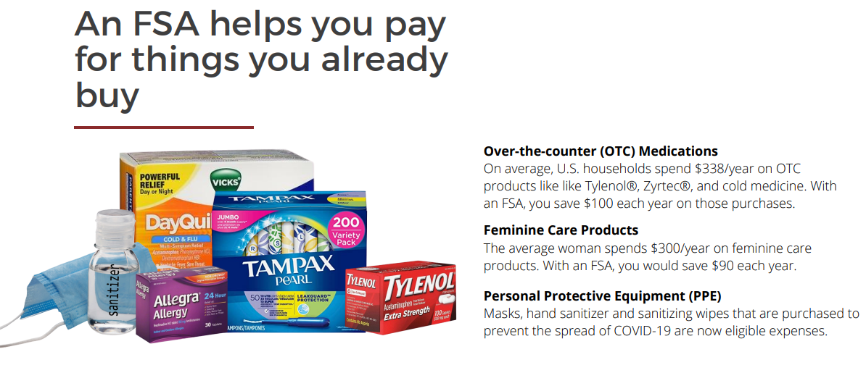
Health Care FSA (HCFSA)
This benefit is used to pay for eligible out-of-pocket expenses that are medically necessary. The health care FSA is a pre-funded. You have access to the full annual election amount at the beginning of the plan year.
Unlike insurance benefits, the health care FSA covers you and your tax dependents even if you are not covered under your employer’s benefit plans.

Slide 5
HCFSA Eligible Expenses
Under IRC Section 213(d), the expense must be to “treat a medical condition” to be considered eligible for reimbursement. This includes common expenses such as:
Copayments, prescriptions, deductible and coinsurance amounts
Dental and orthodontia expenses
Vision expenses such as lenses, contacts, frames etc.
Acupuncture, chiropractic, naturopathic doctors
Over-the-counter medicines

Slide 6
Health Care FSA Ineligible Items
Ineligible expenses include those that are considered hygienic or cosmetic in nature or those that are not treating a medical condition. Some common examples include:
Cosmetic surgery, gym memberships, naturopathic medicines
Teeth whitening, veneers, Sonicare toothbrushes
Visit our web-site at www.naviabenefits.com for an extensive list of eligible and ineligible expenses.

Slide 7
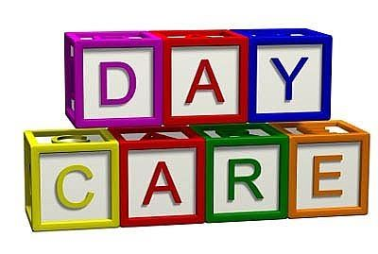
Day Care FSA (DCFSA)
Child care can be a large expenditure for many families. The day care FSA provides some tax relief by allowing families to set aside pre-tax dollars to pay for qualifying expenses. To qualify, the care must:
Be for a dependent 12 and under (unless the dependent is physically or mentally impaired and cannot provide care for themselves, then no age limit)
Enable you and your spouse to work, actively look for work or be a full time student
Not be educational in nature (i.e. school tuition).

Slide 8
Don’t Lose $ Your Plan has Carry Over
The Carry Over provision allows you to carry over up to $660 (IRS max) of unused health care FSA dollars to the following plan year. The carry over amount does not affect your ability to elect the maximum annual election allowed each plan year for the health care FSA.
Example: $660 in carry over funds + $3,300 max = $3,960 for the next plan year.
Any amounts carried over are added to your annual election. If you did not re-enroll in the health care FSA and have a carry over amount, then you’re automatically enrolled in the plan retroactive to the plan start date.
Dependent Care FSAs are not applicable to any carryover

Slide 9
Estimating Your Expenses
Determining your annual election can be hard if you’ve never enrolled in a health care FSA before. Here are some tips to help you determine the appropriate amount.
Call your health insurance carrier and view your out-of-pocket expenses. How many copayments did you pay? Did you meet your deductible? Any coinsurance?
Call your pharmacy and ask for a print-out of your prescription costs for the last year.
Open your medicine cabinet. Most of us turnover our medicine cabinet once a year. Look at what you have and estimate the replacement cost.
Do you have any large expenses coming up? Any upcoming dental work, glasses, orthodontia? You can easily estimate the out-of-pocket costs for these expenses.
If this is your first year enrolling, estimate the above and sign up for half of the amount you think you’ll need.
FSA Tax Calculator - https://www.naviabenefits.com/participants/resources/tax-savings-calculator/

Slide 10
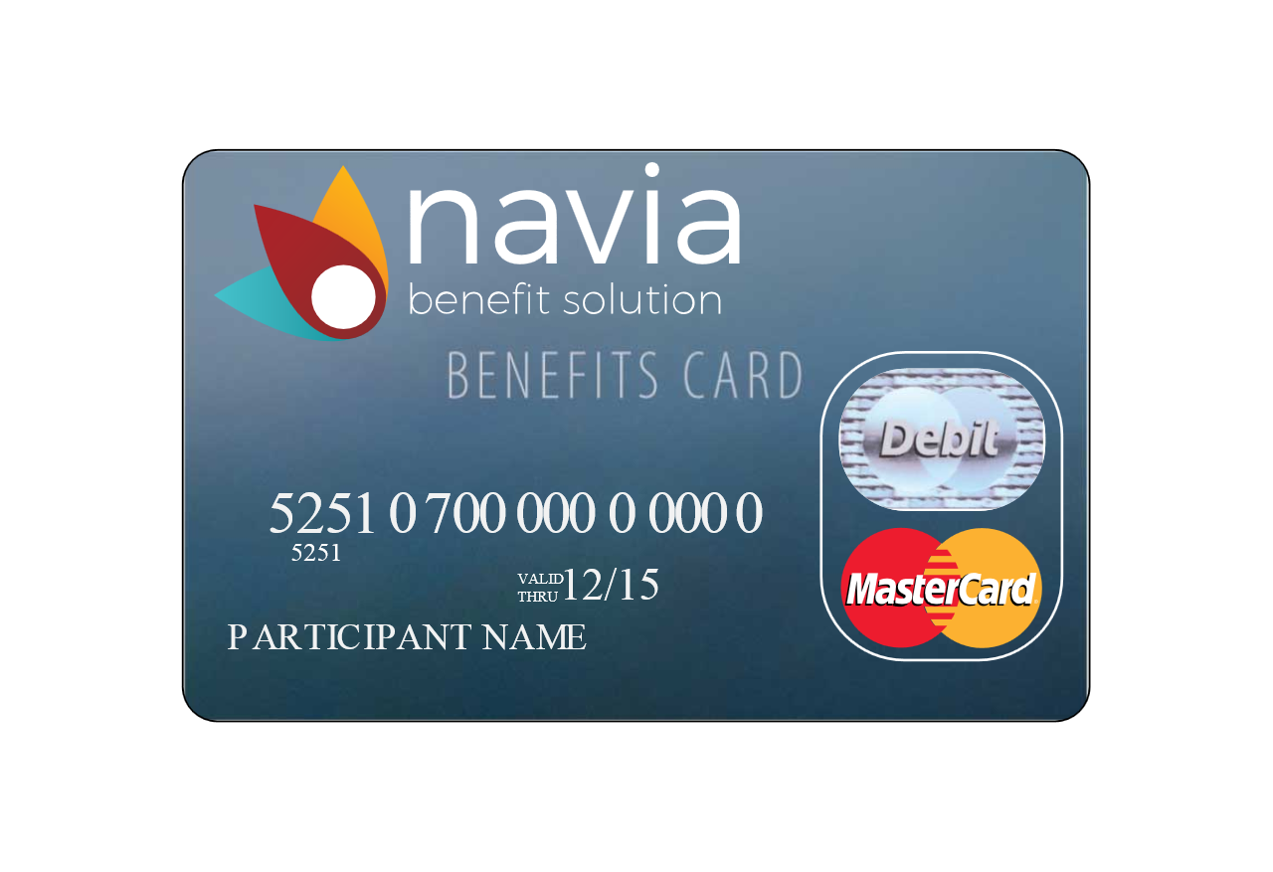
Navia Benefits Card
Rather than filing a claim and waiting for reimbursement, you can use the Navia Benefits Card to pay your provider directly for qualified expenses.
The card is accepted at participating merchants using the IIAS technology system and/or medical merchants setup with the MasterCard system.
Be sure to hang on to your receipts in case we need to see them to verify expense eligibility.
If we need to see a receipt, you will notice an alert on your mobile app and we will send you an email reminder

Slide 11
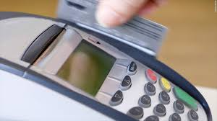
Navia Benefits Card
We may ask you to verify certain card transactions after-the-fact. It’s important to note that Navia only sees the date of transaction, amount of card swipe and the type of merchant. We do not see the following:
Date of Service
Type of Service
Cost of Service
However, Navia is allowed to auto-approve certain transactions without requiring additional documentation.
Swipe amounts that match a copayment amount (or multiple of)
Prescriptions purchased from a pharmacy (physical locations)
Transactions that match the amount and merchant of a previously verified expense

Slide 12
DCFSA
The Day Care FSA calendar year maximum:
$5,000 if you are married filing jointly
$5,000 if you are single
$2,500 if you are married filing separately
The Day Care FSA is not pre-funded; reimbursements are paid based on your account balance.
Eligible Expenses:
Before and after-school care
Day camps
Preschool
Ineligible Expenses:
Overnight camps
Kindergarten
Childcare while you are not working
Care provided by spouse or dependent

Slide 13
Submitting a Claim
We make submitting your claims as easy as possible. You can use one of the following methods:
MyNavia App – An easy-to-use mobile app that gives you real-time access on the go. Available for both Apple and Android devices
FlexConnect – Simple online auto-claim preparation tool for HCFSA
Online Submission – Log into your account at www.naviabenefits.com
Day Care FSA Recurring Claim – Simple online auto-claim tool for DCFSA
Paper Claim Form – Mail, fax or email your claim and documentation to us
Allow up to two (2) full business days for your claim to be processed. Reimbursements are issued according to your employer’s reimbursement schedule.
Or, use the Navia Benefits Card and skip the claim filing step!!!

Slide 14
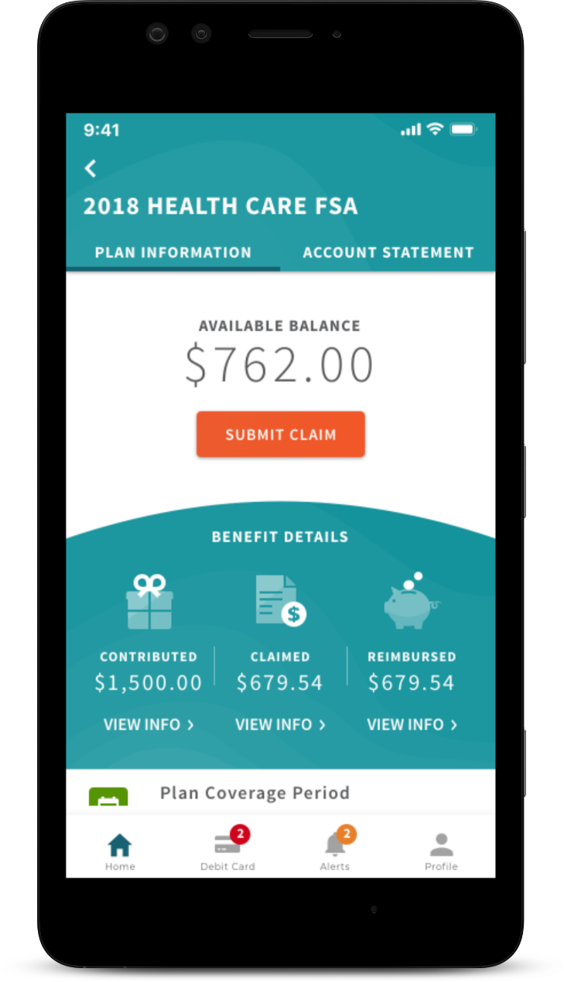
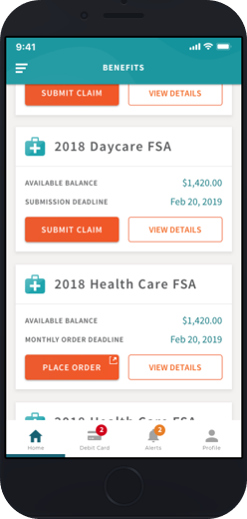
MyNavia App
The MyNavia App gives you real-time access on the go!
Submit your claims
Claim approval & reimbursement notifications
Update personal information
Substantiate debit card transactions
View active benefits and claims history
View pending claims
Available for download on Google Play and the Apple Store.

Slide 15
FlexConnect
Now you can FlexConnect your FSA
to your Medical, Dental and Vision carriers’ websites!
Step 1.
Enter Carriers
Step 2.
Enter Username/Password
Step 3.
Click “Reimburse me!”

Slide 16
Enrolling in the Plan
EXPLAIN HOW EMPLOYEE’s will enroll and DATES
Remember, your annual election is deducted evenly between your pay checks during the plan year.

Slide 17
Support
Our dedicated staff of customer service agents are available to assist you, Monday through Friday, between the hours of 5:00 am and 5:00 pm (PST). You can reach our customer service at (425) 452-3500 or toll-free at (800) 669-3539.
If email is more convenient, customer service can also be reached at customerservice@naviabenefits.com.

