Slide 1
2025 Open Enrollment
Open Enrollment Period:
November 1, 2024 – November 15, 2024
Benefits Period:
January 1, 2025 – December 31, 2025

Slide 2
Introduction
Ines Fontanella, Sr. Manager, Global Benefits
Rimini Street
Caryn Moloney, Senior Account Manager
Woodruff Sawyer

Slide 4
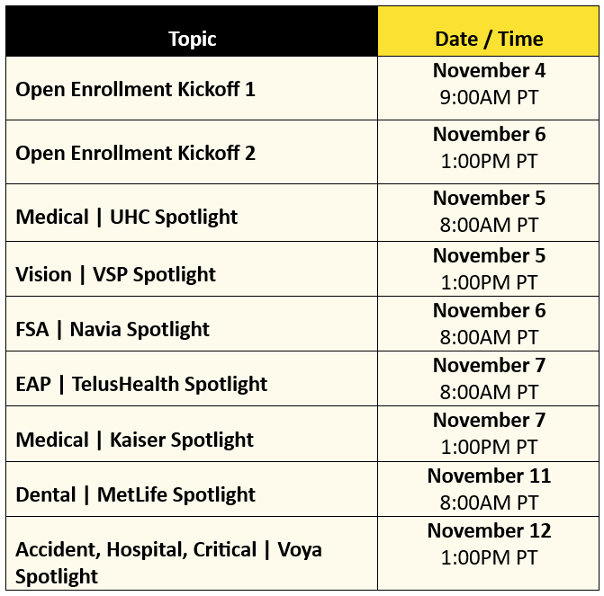
Vendor Spotlights - Reminder
Win a wellness prize!
30-minute sessions with our benefit vendors
Stay to the end of the presentation and you could be a lucky winner!
Per the IRS, wellness incentives under $100 are not subject to taxes.
If applicable, Rimini will gross up the value of the prize to account for taxes owed.
Apple Watch
Under Desk Elliptical
Desk Chair Massage Pad
Yoga Mat w/Yoga Blocks
Pilates Ring and Ball Set
Back Shoulder and Neck Massager
Foot Massager
Deep Tissue Massage Gun
Body Weight Vest

Slide 5
What You Need To Know
No action is required
If you wish to rollover current elections to 2025
~Passive Enrollment ~
Action is Required
If you wish to participate in
FSA and HSA
in 2025
Medical Waiver is required
If choosing the
Medical Opt-Out-Credit
Add, cancel, change coverage for you and dependents
Requirement
Assign Beneficiaries
and update
Emergency Contact
DEADLINE
November 15
11:59pm PST
Changes become effective January 1, 2025
Next opportunity: If you experience a Qualifying Life Event

Slide 6
Changes for 2025
NO CHANGES to our Benefits coverage except required mandates to the HDHP (HSA plan).
Individual annual deductible increase: $3,200 to $3,300.
Telemedicine Visits are no longer offered at zero cost.
Increase to Medical Contributions.
Tax Deferred Programs Increases:
FSA Health Care and Limited Purpose: $3,200 to $3,300
Parking and Transit: $315 to $325
HSA: $4,150 to $4,300 single | $8,300 to $8,550 family
Retirement - 401(k)
Eligibility for the Employer Match is now 6 months (from previous 1yr of service)
Continue in 2025
Rimini pays 100% Employee Only Coverage
Rimini continues subsidizing your dependent coverage

Slide 7
Benefit Program Overview
Four Medical Plan Options
UHC PPO 1500
UHC PPO 250
UHC HDHP w/HSA
Kaiser Medical: Kaiser HMO (CA only)
Dental: MetLife Dental DPPO
Vision: VSP PPO
Life/AD&D, Voluntary Life and AD&D: LFG
(Lincoln Financial Group)
Short-Term and Long-Term Disability: LFG
(Lincoln Financial Group)
Flexible Spending Account: Navia Benefits
Health Savings Account: Optum
Supplemental Plans: Accident, Critical illness & Hospital: Voya Financial
Employee Assistance Program: Telus Health
Pet Insurance: Figo
Commuter and Transit: Navia Benefits
Retirement | 401(k): Fidelity
Not included in the open enrollment process
For specific details on plan coverage, please review the Benefit Guide located at
Rimini Street Benefits Page

Slide 8
2025 Premiums
Semi-monthly Employee Premiums vs. Semi-monthly Rimini Premiums
Coverage Type | Kaiser HMO (CA Only) | UHC PPO 250 | UHC PPO 1500 | UHC HSA
Employee Only | $0.00 | $0.00 | $0.00 | $0.00
Rimini Street Pays | $456.32 | $623.31 | $531.84 | $450.78
Employee + Spouse | $240.94 | $370.25 | $269.08 | $188.43
Rimini Street Pays | $762.96 | $1,001.03 | $900.82 | $803.29
Employee + Child(ren) | $200.78 | $246.84 | $162.72 | $97.37
Rimini Street Pays | $711.86 | $875.14 | $794.46 | $714.04
Employee + Family | $438.07 | $656.98 | $511.03 | $391.28
Rimini Street Pays | $930.89 | $1,275.30 | $1,137.46 | $1,006.13
Rimini HSA Funding | N/A | N/A | N/A | $1,500 Ind. $2,500 Fam.
NO CHANGE: Rimini will continue to pay 100% for employee only coverage and will continue to subsidize the dependent coverage.

Slide 9
2025 Premiums
Semi-monthly Employee Premiums vs. Semi-monthly Rimini Premiums
Coverage Type | MetLife Dental | Vision (VSP)
Employee Only | $0.00 | $0.00
Rimini Street Pays | $21.58 | $7.28
Employee + Spouse | $10.14 | $2.41
Rimini Street Pays | $33.42 | $10.06
Employee + Child(ren) | $12.95 | $2.47
Rimini Street Pays | $36.12 | $10.26
Employee + Family | $22.56 | $5.99
Rimini Street Pays | $47.39 | $14.54
NO CHANGE: Rimini will continue to pay 100% for employee only coverage and will continue to subsidize the dependent coverage.

Slide 10
Medical Options
Considerations in selecting a medical plan
Ask yourself…
UHC HDHP w/HSA
UHC PPO 250
What is my budget and the cost of coverage, including payroll contributions?
What kind of healthcare needs do my dependents, and I have?
How much do I spend each year on out-of-pocket medical expenses?
What types of prescription drugs will my household need?
What services are Preventive at 100% insurance paid?
Lowest paycheck cost
Pay more at the time of service
Build account and save for future expenses
“Free” money from Rimini
Highest paycheck cost
Higher copays
Lower deductible and Out-of-pocket max.
Pay more upfront through your paycheck pay less at the time of service
UHC PPO 1500
Kaiser HMO Plan (CA)
Mid-range cost
Lower copays
Higher deductible and Out-of-pocket max vs. PPO 250
Mid-range cost
Limited to Kaiser network except in an emergency
Understand your budget and cost to identify a plan based on your needs.

Slide 11
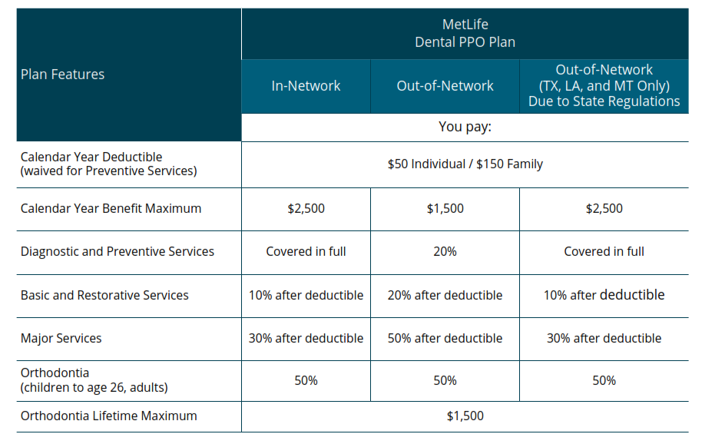
MetLife Dental
Dental PPO 2025
Note: TX, LA and MT requires the Out-of-Network coverages be the same as In-Network

Slide 12
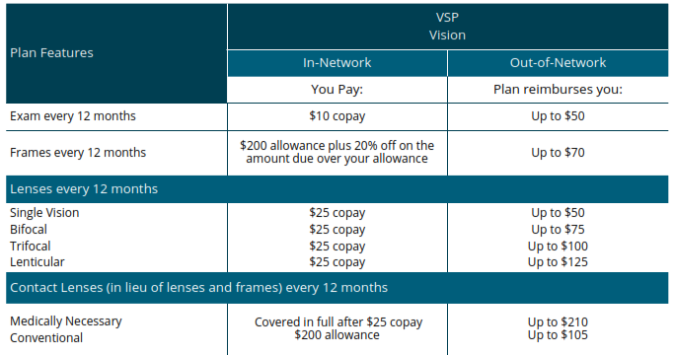
VSP Vision Plan
Vision PPO 2025

Slide 13
HSA (Optum Bank)
What is a Health Savings Account?
Do you qualify for a Health Savings Account?
Personal account
Save for healthcare expenses: Medical | Dental | Vision
Contribution Types:
Pre-Tax through payroll deductions
Post-Tax methods
IRS required that you participate in a qualified HDHP
You or your spouse do not participate in a Health FSA.
Not enrolled in Medicare

Slide 14
Navia Benefit
Medical FSA & Limited Purpose FSA
Contribute up to $3,300
Funds available immediately
Pay for eligible expenses
Rollover up to $660
unused funds to 2026
Eligible expenses include:
Copays | Coinsurance | Deductibles | Orthodontia | Glasses | And more
Limited Purpose FSA: HDHP participants | Dental and Vision expenses
Notes:
limited FSA only available for dental and vision

Slide 15
Navia Benefit
Dependent Care FSA
Contribute up to $5,000
Funds available up to the amount in the account
Pay for eligible expenses
Use-it or lose-it benefit, plan carefully
Eligible expenses include:
Live-in Care | Licensed Daycare | Preschool | Day Camps

Slide 16
Navia Benefit
Commuter Benefit Plan
Enrollment is not through Open Enrollment
ONLY available in San Francisco Metro and Chicago.
Deduct pre-tax money from your paycheck to pay for transit and parking related expenses.
Monthly Deadline: 15th of every month for the following benefit month.
Eligible commute-related expenses:
Bus, subway, MUNI, BART, and train fare
Vanpool expenses
Parking fees
Maximum Contribution
Transit | $325 per month
Parking | $325 per month
Increase for 2025

Slide 17
Next Steps
01

Slide 18
How to Enroll
Enrolling through Workday
Login to Okta using your network credentials: https://riministreet.okta.com/
Click the Workday (Self Login) Chicklet
Your Open Enrollment Event will be in your Workday Inbox
Upper right-hand corner of the screen

Slide 19
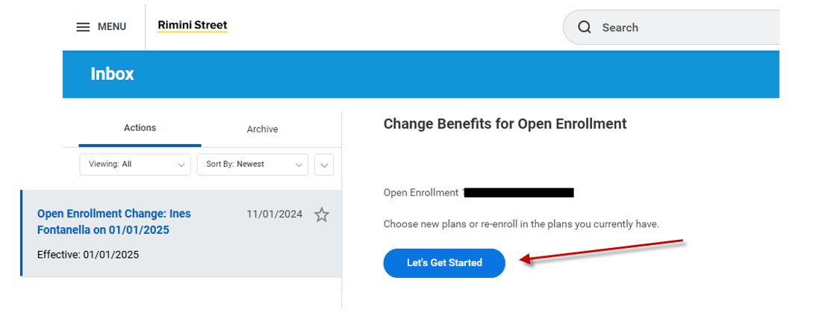
How to Enroll
DEADLINE: 11/15/2024
(11:59PM PST)
Enrolling through Workday
Click “Let’s Get Started”

Slide 20
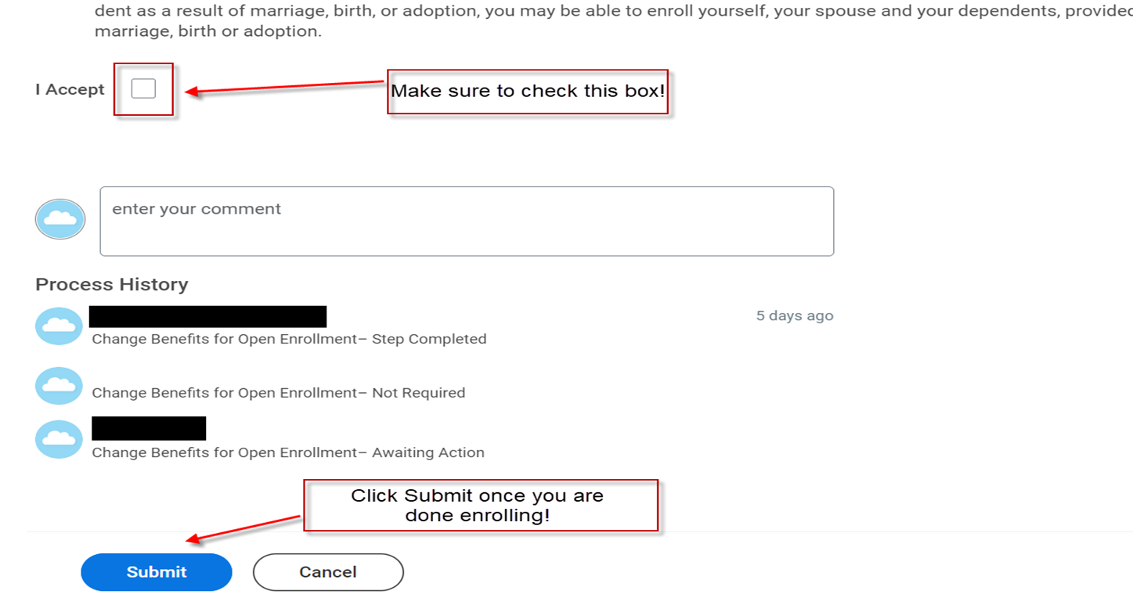
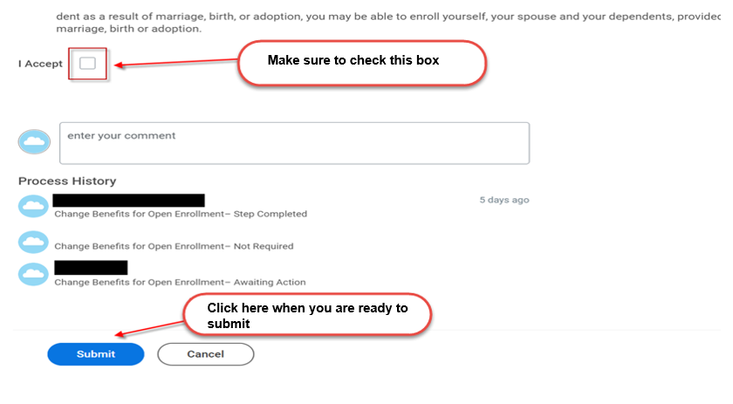
How to Enroll
Now that you are almost done
Check mark the “I Accept” box
Click “Submit” to complete your 2025 Open Enrollment Event

Slide 21
Benefit Questions
We are here to help
Email:
Benefits@riministreet.com
HR Ticket via the Intranet
HR Ticket Link
Open Enrollment Benefits Page
Benefits Link

Slide 22
Thank You!
Ines Fontanella
Sr. Manager, Global Benefits
benefits@riministreet.com

